Slide 1
{brand_name}
Audience360 Post Campaign Report
{date_}

Slide 2
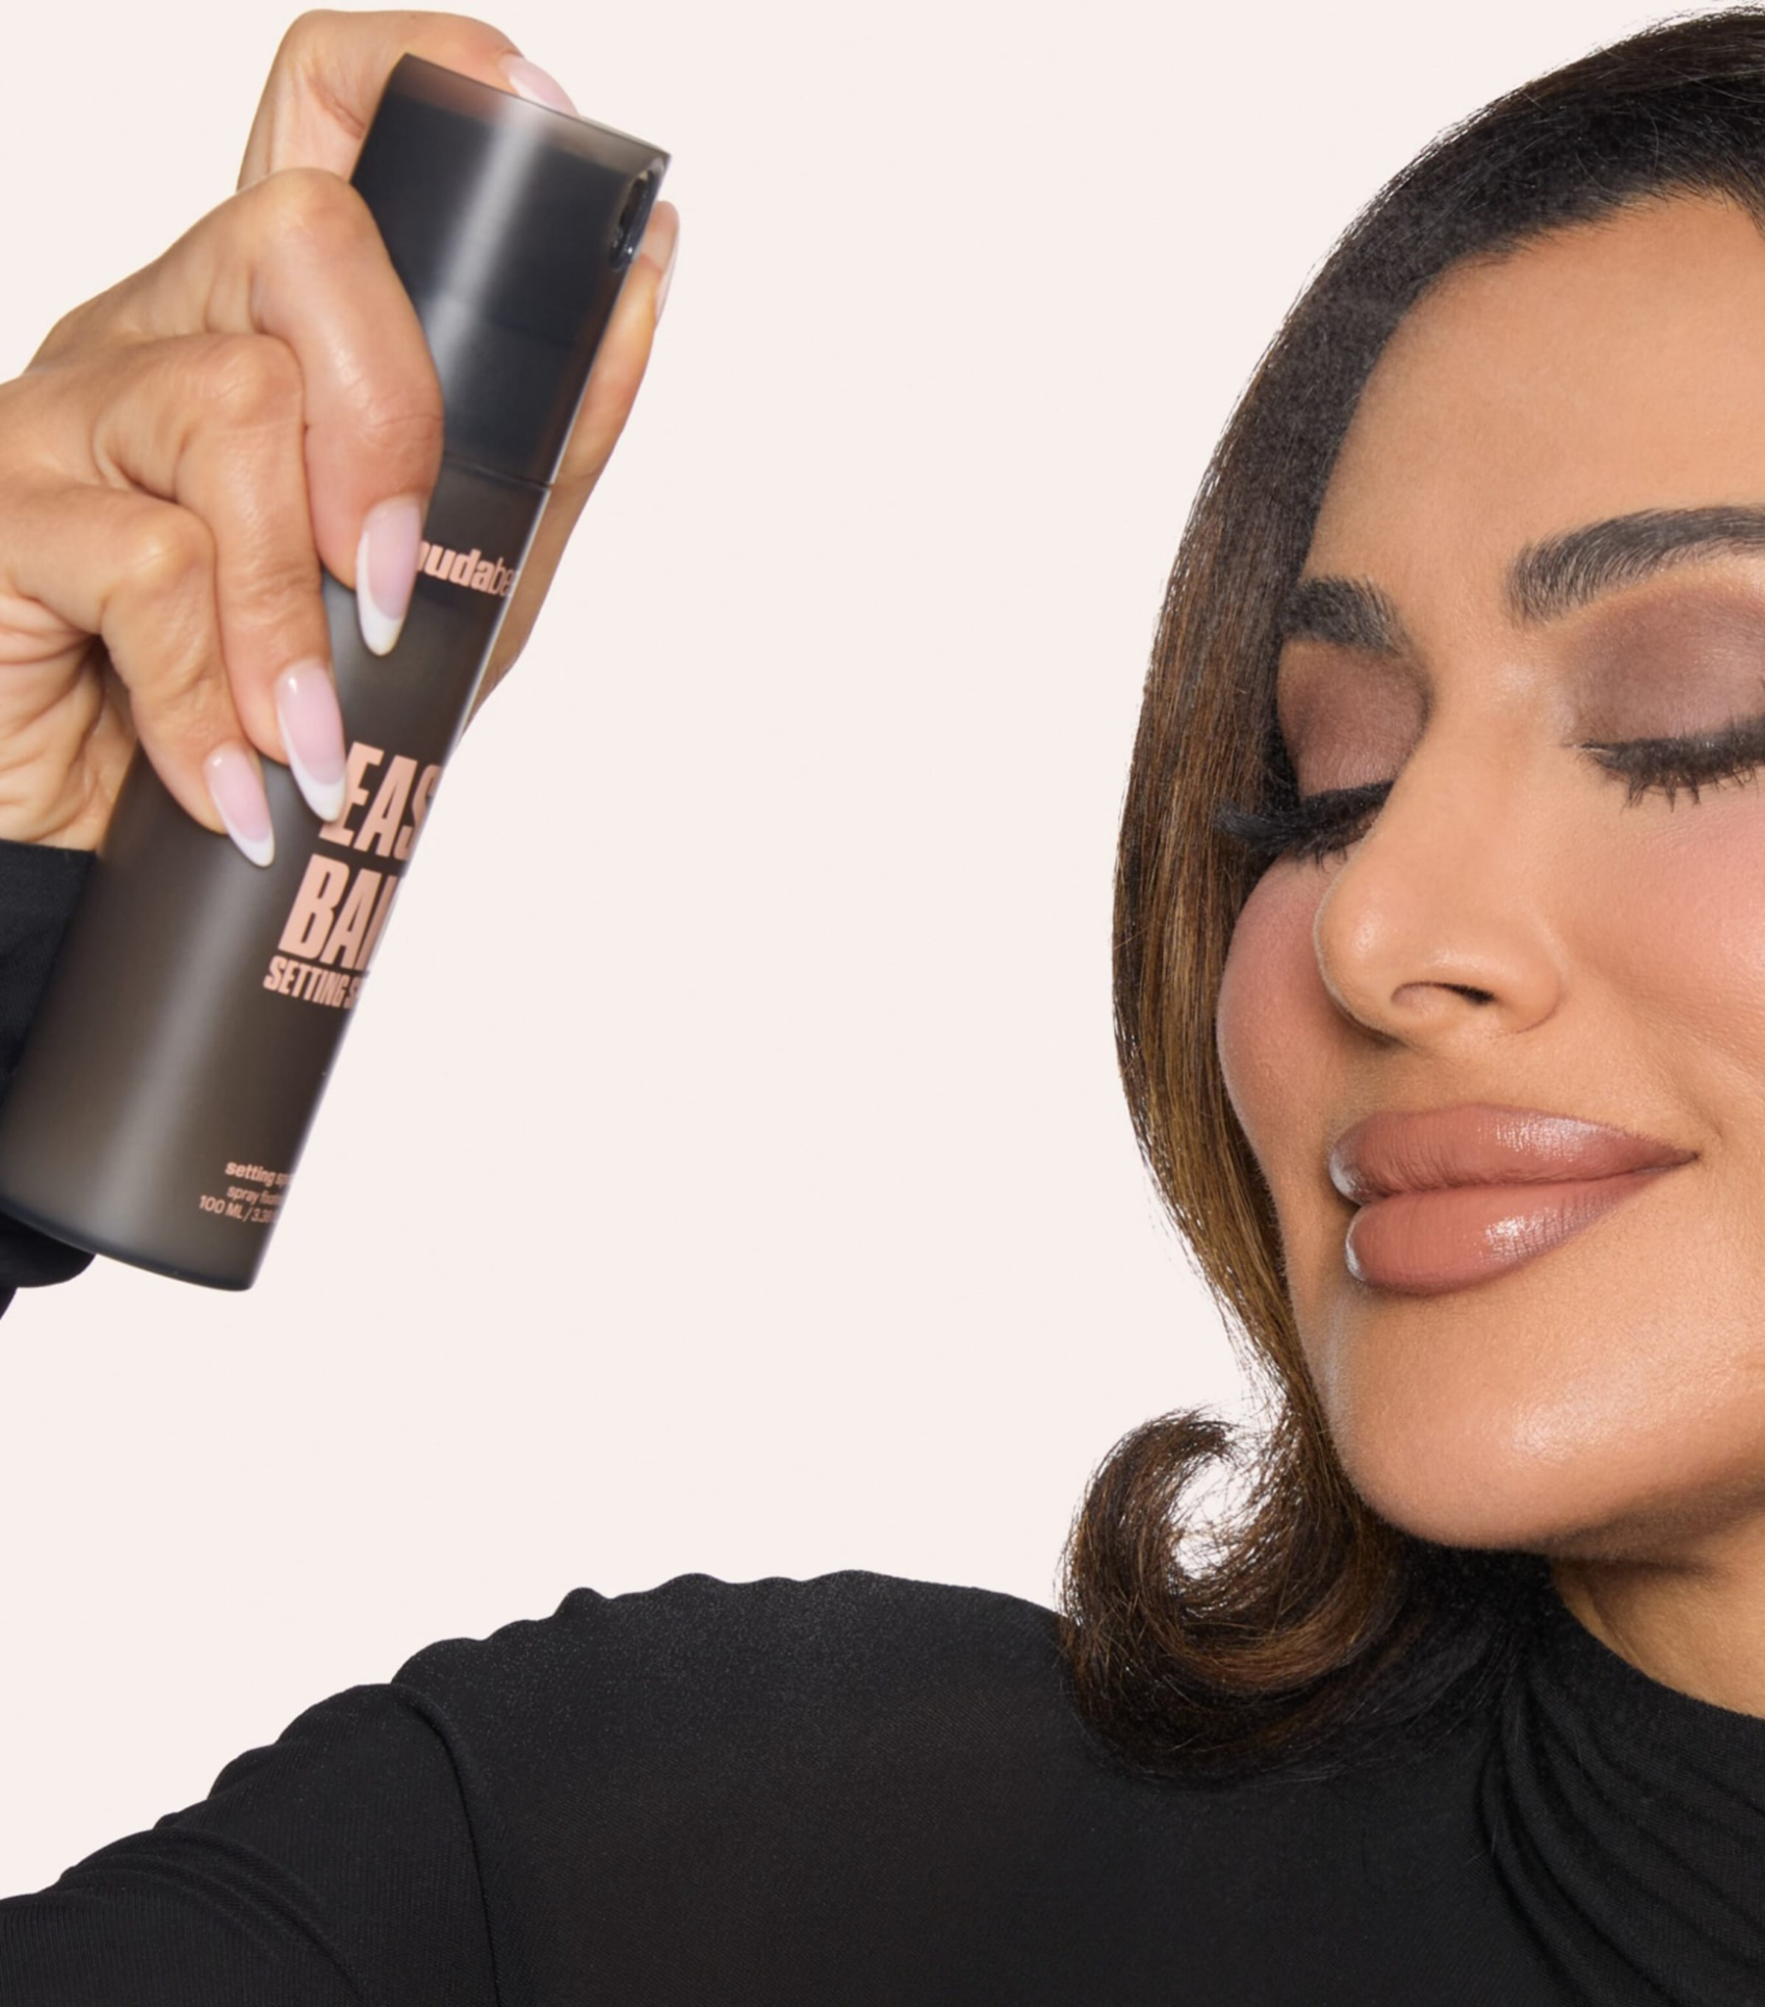
01
Campaign brief summary
02
Post campaign report
Overall campaign performance
Audience breakdown
Creative analysis
03
Learnings & Recommendations
04
Channels
{channel1}
{channel2}

Slide 3
01
Campaign Brief Summary
OUR APPROACH

Slide 4
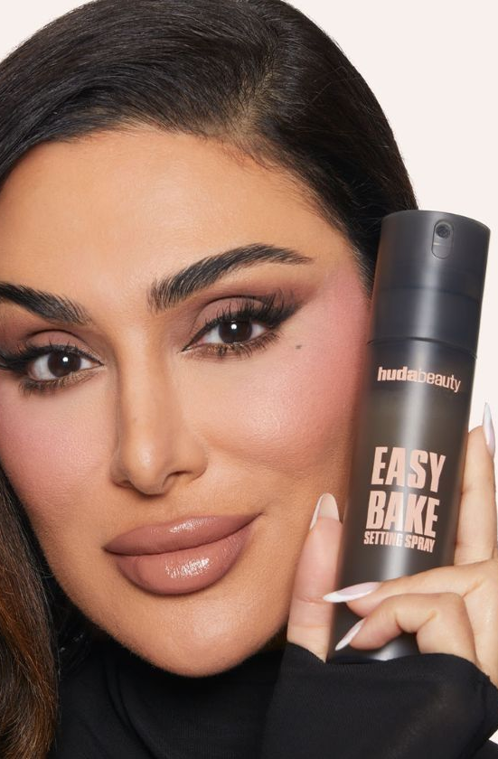
Campaign Summary
Brand:
{brand_name}
Campaign:
{campaign_name}
Flight Dates:
{flight_dates}
Channels:
{channels}
Objective
{campaign_objective}
Primary KPIs:
{primary_kpis}
Secondary KPIs:
{secondary_kpis}
Further measurement:
{further_measurements}
Notes:
Updated

Slide 5

{overall_campaign_performance_commentary}
Objective: CTR
{overall_engagement_performance_commentary}
Objective: Sales, Revenue & ROI
{overall_sales_revenue_ROI_performance_commentary}
Objective: CPM and Reach
{overall_reach_performance_commentary}

Slide 6
02
Post Campaign Report
The following analysis is based on exposed audience.

Slide 7
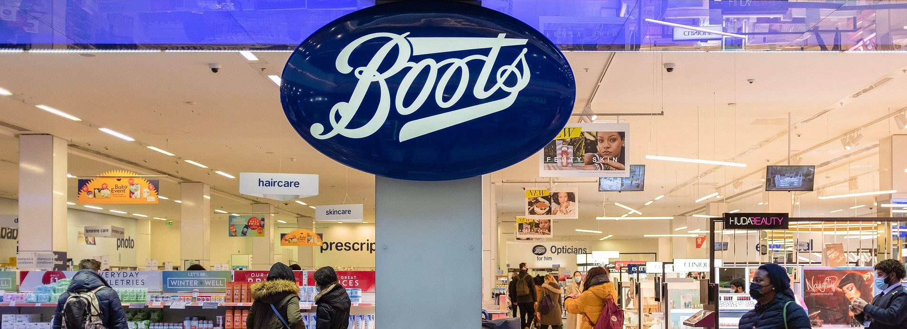







Total Campaign Summary
Delivery Performance
GROSS
SPEND
IMPRESSIONS
UNIQUE REACH
FREQUENCY
CLICKS
CTR
Net CPM
£{gross_spend}
{impressions}
{N/A}
{N/A}
{clicks}
{ctr}
£{net_cpm}
Estimated:
£{gross_est}
Estimated:
{imp_est}
Estimated:
{reach_est}
Estimated:
{freq_est}
Estimated:
{click_est}
Estimated:
{ctr_est}
Estimated:
£{net_cpm_est}
Notes:
check on frequency

Slide 8
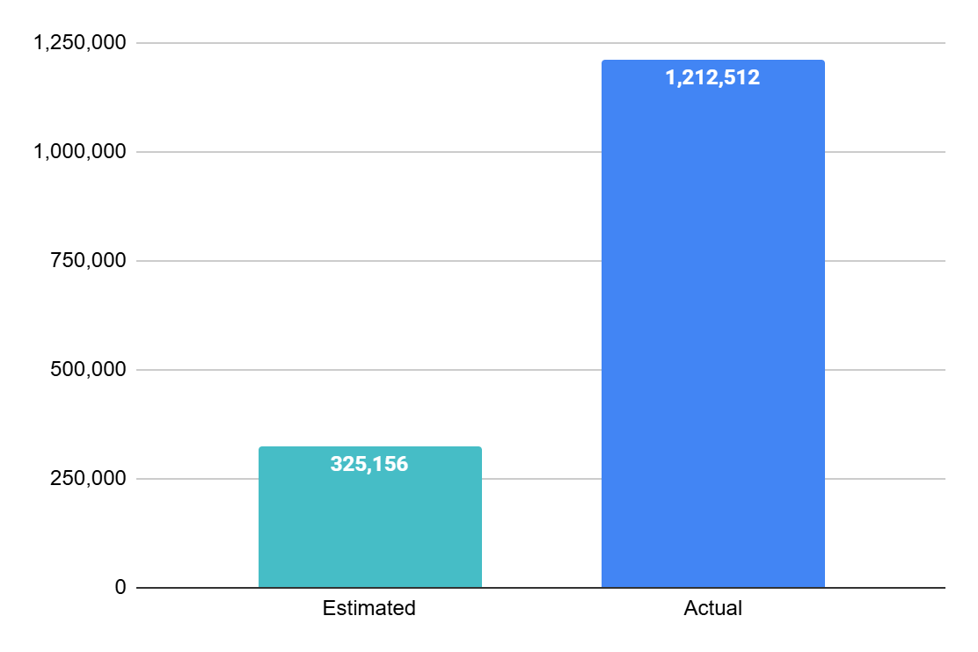
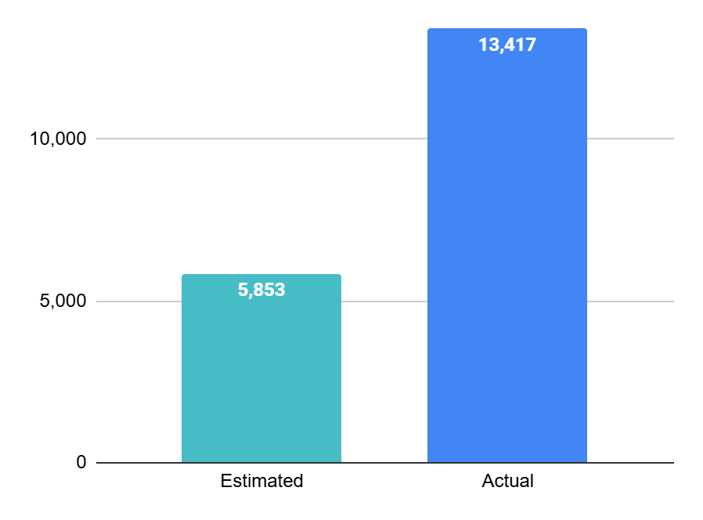
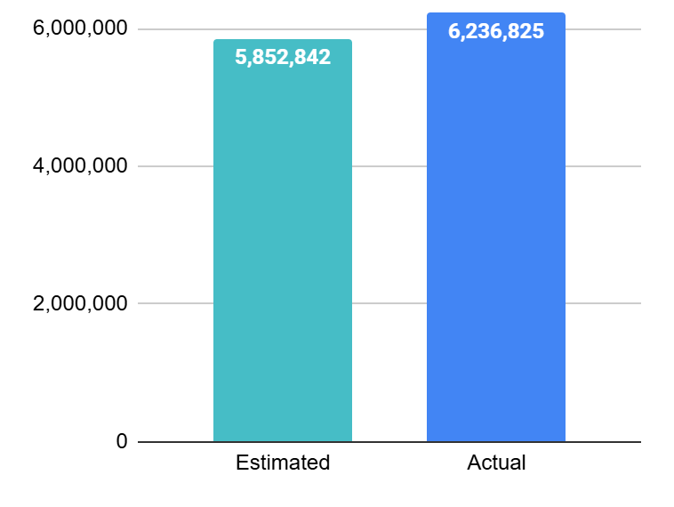
{estimated_versus_actual_performance_commentary}
{perc_imp}
N/A
{perc_clicks}
IMPRESSIONS
Reach
Clicks
Notes:
OK

Slide 9
{channel_performance_commentary}
Reach
Impressions
CTR
Net CPM
Link Clicks
Gross Spend
Brand Revenue
Product Revenue*
Overall
{reach}
{impressions}
{ctr}
£{net_cpm}
{clicks}
£{gross_spend}
£{brand_rev}
£{brand_roas} ROAS
£{brand_roi} ROI
£{fsku_rev}
£{fsku_roas} ROAS
£{fsku_roi} ROI
Meta
{meta_reach}
{meta_impressions}
{meta_ctr}
£{meta_net_cpm}
{meta_clicks}
£{meta_gross_spend}
£{meta_brand_rev}
£{meta_brand_roas} ROAS
£{meta_brand_roi} ROI
£{meta_fsku_rev}
£{meta_fsku_roas} ROAS
£{meta_fsku_roi} ROI
Pinterest
{pin_reach}
{pin_impressions}
{pin_ctr}
£{pin_net_cpm}
{pin_clicks}
£{pin_gross_spend}
£{pin_brand_rev}
£{pin_brand_roas} ROAS
£{pin_brand_roi} ROI
£{pin_fsku_rev}
£{pin_fsku_roas} ROAS
£{pin_fsku_roi} ROI
TikTok
{tik_reach}
{tik_impressions}
{tik_ctr}
£{tik_net_cpm}
{tik_clicks}
£{tik_gross_spend}
£{tik_brand_rev}
£{tik_brand_roas} ROAS
£{tik_brand_roi} ROI
£{tik_fsku_rev}
£{tik_fsku_roas} ROAS
£{tik_fsku_roi} ROI
*Product measurement is only available on Meta.

Slide 10
{brand_and_fsku_roas_performance_wrt_overall_traffic_performance_commentary}
Brand Units
{brand_units}
Brand Revenue
{brand_rev}
Brand ROAS
{brand_roas}
FSKU Units
{fsku_ units}
FSKU Revenue
{fsku_rev}
FSKU ROAS
{fsku_ roas}
Notes:
Note this only considers Meta data since we cannot attribute TikTok sales

Slide 11
{percentage_of_instore_online_sales_commentary}
Online Unit Sales
{online_units}
Online Revenue
{online_revenue}
Online AOV
{online_aov}
In Store Unit Sales
{instore_units}
In Store Revenue
{online_revenue}
In Store AOV
{instore_aov}

Slide 12
Post-campaign Report: Meta
The following analysis is based on exposed audience.

Slide 13
Meta Campaign Summary
Delivery Performance
GROSS
SPEND
IMPRESSIONS
UNIQUE REACH
FREQUENCY
CLICKS
CTR
Net CPM
£{meta_gross_spend}
{meta_impressions}
£{meta_reach}
{meta_freq}
{meta_clicks}
{meta_ctr}
£{meta_net_cpm}
Estimated:
£{meta_est_spend}
Estimated:
£{meta_est_imp}
Estimated:
£{meta_est_reach}
Estimated:
£{meta_est_freq}
Estimated:
£{meta_est_clicks}
Estimated:
{meta_est_ctr}
Estimated:
£{meta_est_cpm}

Slide 14
{meta_audience_performance_commentary}
Strongest sales performance from brand-loyal customers
{meta_two_audiences_with_strongest_roas_commentary}
Broad category and competitor audiences helped drive awareness
{meta_intuitive_commentary_about_audience_performance_commentary}

Slide 15
{meta_ad_with_strongest_roas_and_impressions_commentary}
IMPRESSIONS:
{adwithstrongestroas_imp_m}
REACH:
{adwithstrongestroas _reach_m}
SPEND:
£{adwithstrongestroas_spend_m}
FREQ:
{adwithstrongestroas _freq_m}
ROAS:
{adwithstrongestroas _roas_m}
CPM:
£{adwithstrongestroas_cpm_m}
LINK CLICKS:
{adwithstrongestroas _clicks_m}
CTR:
{adwithstrongestroas_ctr_m}
{meta_ad_with_strongest_roas_picture}
​
{meta_ad_with_strongest_roas_picture_description}
​

Slide 16
{meta_ad_with_weakest_roas_and_impressions_commentary}
IMPRESSIONS:
{adwithweakestroas_imp_m}
REACH:
{adwithweakestroas _reach_m}
SPEND:
£{adwithweakestroas_spend_m}
FREQ:
{adwithweakestroas _freq_m}
ROAS:
{adwithweakestroas _roas_m}
CPM:
£{adwithweakestroas_cpm_m}
LINK CLICKS:
{adwithweakestroas _clicks_m}
CTR:
{adwithweakestroas_ctr_m}
{meta_ad_with_weakest_roas_picture}
​
{meta_ad_with_weakest_roas_picture_description}
​

Slide 17
Audience Performance breakdown
Audience Segment | Net Spend | Impressions | Reach | Frequency | Clicks | CTR | Net CPM | Brand Revenue | Brand ROI | Brand ROAS
{m_aud_1} | {m_netspend_1} | {m_imp_1} | {m_reach_1} | {m_freq_1} | {m_clicks_1} | {m_ctr_1} | {m_netcpm_1} | {m_revenue_1} | {m_roi_1} | {m_roas_1}
{m_aud_2} | {m_netspend_2} | {m_imp_2} | {m_reach_2} | {m_freq_2} | {m_clicks_2} | {m_ctr_2} | {m_netcpm_2} | {m_revenue_2} | {m_roi_2} | {m_roas_2}
{m_aud_3} | {m_netspend_3} | {m_imp_3} | {m_reach_3} | {m_freq_3} | {m_clicks_3} | {m_ctr_3} | {m_netcpm_3} | {m_revenue_3} | {m_roi_3} | {m_roas_3}
{m_aud_4} | {m_netspend_4} | {m_imp_4$} | {m_reach_4} | {m_freq_4} | {m_clicks_4} | {m_ctr_4} | {m_netcpm_4} | {m_revenue_4} | {m_roi_4} | {m_roas_4}
{m_aud_5} | {m_netspend_5} | {m_imp_5} | {m_reach_5} | {m_freq_5} | {m_clicks_5} | {m_ctr_5} | {m_netcpm_5} | {m_revenue_5} | {m_roi_5} | {m_roas_5}
{m_aud_6} | {m_netspend_6} | {m_imp_6} | {m_reach_6} | {m_freq_6} | {m_clicks_6} | {m_ctr_6} | {m_netcpm_6} | {m_revenue_6} | {m_roi_6} | {m_roas_6}
{m_aud_7} | {m_netspend_7} | {m_imp_7} | {m_reach_7} | {m_freq_7} | {m_clicks_7} | {m_ctr_7} | {m_netcpm_7} | {m_revenue_7} | {m_roi_7} | {m_roas_7}
{m_aud_8} | {m_netspend_8} | {m_imp_8} | {m_reach_8} | {m_freq_8} | {m_clicks_8} | {m_ctr_8} | {m_netcpm_8} | {m_revenue_8} | {m_roi_8} | {m_roas_8}
{m_aud_9} | {m_netspend_9} | {m_imp_9} | {m_reach_9} | {m_freq_9} | {m_clicks_9} | {m_ctr_9} | {m_netcpm_9} | {m_revenue_9} | {m_roi_9} | {m_roas_9}
{m_aud_10} | {m_netspend_10} | {m_imp_10} | {m_reach_10} | {m_freq_10} | {m_clicks_10} | {m_ctr_10} | {m_netcpm_10} | {m_revenue_10} | {m_roi_10} | {m_roas_10}
{m_aud_11} | {m_netspend_11} | {m_imp_11} | {m_reach_11} | {m_freq_11} | {m_clicks_11} | {m_ctr_11} | {m_netcpm_11} | {m_revenue_11} | {m_roi_11} | {m_roas_11}
{m_aud_12} | {m_netspend_12} | {m_imp_12} | {m_reach_12} | {m_freq_12} | {m_clicks_12} | {m_ctr_12} | {m_netcpm_12} | {m_revenue_12} | {m_roi_12} | {m_roas_12}

Slide 18
How many Brand sales did our Meta campaign drive?
Metrics | Total Issey Miyake
Gross Spend | {meta_gross_spend}
Brand revenue | {meta_brand_revenue}
Brand ROAS | {meta_brand_roas}
Brand ROI | {meta_brand_roi}
Brand online revenue | {meta_brand_online_revenue}
Brand instore revenue | {meta_brand_instore_revenue}
Brand online % of sales | {meta_brand_online_perc_sales}
Brand instore % of sales | {meta_brand_instore_perc_sales}
Notes:
updated

Slide 19
How many Featured product sales did our Meta campaign drive?
Metrics | Total Issey Miyake FSKUs
Gross Spend | {meta_gross_spend}
FSKU revenue | {meta_fsku_revenue}
FSKU ROAS | {meta_fsku_roas}
FSKU ROI | {meta_fsku_roi}
FSKU online revenue | {meta_fsku_online_revenue}
FSKU instore revenue | {meta_fsku_instore_revenue}
FSKU online % of sales | {FSKU_online_perc_sales_meta}
FSKU instore % of sales | {FSKU_instore_perc_sales_meta }
Notes:
updated

Slide 20
Post-campaign Report: TikTok
The following analysis is based on exposed audience.

Slide 21
TikTok Campaign Summary
Delivery Performance
GROSS
SPEND
IMPRESSIONS
UNIQUE REACH
FREQUENCY
CLICKS
CTR
Net CPM
£{tik_gross_spend}
{tik_impressions}
£{tik_reach}
{tik_freq}
{tik_clicks}
{tik_ctr}
£{tik_net_cpm}
Estimated:
£{tik_est_spend}
Estimated:
£{tik_est_imp}
Estimated:
£{tik_est_reach}
Estimated:
£{tik_est_freq}
Estimated:
£{tik_est_clicks}
Estimated:
{tik_est_ctr}
Estimated:
£{tik_est_cpm}

Slide 22
{tik_audience_performance_commentary}
Strongest sales performance from brand-loyal customers
{tik_two_audiences_with_strongest_roas_commentary}
Broad category and competitor audiences helped drive awareness
{tik_intuitive_commentary_about_audience_performance_commentary}

Slide 23
{tik_ad_with_strongest_roas_and_impressions_commentary}
IMPRESSIONS:
{adwithstrongestroas_imp_t}
REACH:
{adwithstrongestroas _reach_t}
SPEND:
£{adwithstrongestroas_spend_t}
FREQ:
{adwithstrongestroas _freq_t}
ROAS:
{adwithstrongestroas _roas_t}
CPM:
£{adwithstrongestroas_cpm_t}
LINK CLICKS:
{adwithstrongestroas _clicks_t}
CTR:
{adwithstrongestroas_ctr_t}
{tik_ad_with_strongest_roas_picture}
​
{tik_ad_with_strongest_roas_picture_description}
​

Slide 24
{tik_ad_with_weakest_roas_and_impressions_commentary}
IMPRESSIONS:
{adwithweakestroas_imp_t}
REACH:
{adwithweakestroas _reach_t}
SPEND:
£{adwithweakestroas_spend_t}
FREQ:
{adwithweakestroas _freq_t}
ROAS:
{adwithweakestroas _roas_t}
CPM:
£{adwithweakestroas_cpm_t}
LINK CLICKS:
{adwithweakestroas _clicks_t}
CTR:
{adwithweakestroas_ctr_t}
{tik_ad_with_weakest_roas_picture}
​
{tik_ad_with_weakest_roas_picture_description}
​

Slide 25
Audience Performance breakdown
Audience Segment | Net Spend | Impressions | Reach | Frequency | Clicks | CTR | Net CPM | Brand Revenue | Brand ROI | Brand ROAS
{t_aud_1} | {t_netspend_1} | {t_imp_1} | {t_reach_1} | {t_freq_1} | {t_clicks_1} | {t_ctr_1} | {t_netcpm_1} | {t_revenue_1} | {t_roi_1} | {t_roas_1}
{t_aud_2} | {t_netspend_2} | {t_imp_2} | {t_reach_2} | {t_freq_2} | {t_clicks_2} | {t_ctr_2} | {t_netcpm_2} | {t_revenue_2} | {t_roi_2} | {t_roas_2}
{t_aud_3} | {t_netspend_3} | {t_imp_3} | {t_reach_3} | {t_freq_3} | {t_clicks_3} | {t_ctr_3} | {t_netcpm_3} | {t_revenue_3} | {t_roi_3} | {t_roas_3}
{t_aud_4} | {t_netspend_4} | {t_imp_4} | {t_reach_4} | {t_freq_4} | {t_clicks_4} | {t_ctr_4} | {t_netcpm_4} | {t_revenue_4} | {t_roi_4} | {t_roas_4}
{t_aud_5} | {t_netspend_5} | {t_imp_5} | {t_reach_5} | {t_freq_5} | {t_clicks_5} | {t_ctr_5} | {t_netcpm_5} | {t_revenue_5} | {t_roi_5} | {t_roas_5}
{t_aud_6} | {t_netspend_6} | {t_imp_6} | {t_reach_6} | {t_freq_6} | {t_clicks_6} | {t_ctr_6} | {t_netcpm_6} | {t_revenue_6} | {t_roi_6} | {t_roas_6}
{t_aud_7} | {t_netspend_7} | {t_imp_7} | {t_reach_7} | {t_freq_7} | {t_clicks_7} | {t_ctr_7} | {t_netcpm_7} | {t_revenue_7} | {t_roi_7} | {t_roas_7}
{t_aud_8} | {t_netspend_8} | {t_imp_8} | {t_reach_8} | {t_freq_8} | {t_clicks_8} | {t_ctr_8} | {t_netcpm_8} | {t_revenue_8} | {t_roi_8} | {t_roas_8}
{t_aud_9} | {t_netspend_9} | {t_imp_9} | {t_reach_9} | {t_freq_9} | {t_clicks_9} | {t_ctr_9} | {t_netcpm_9} | {t_revenue_9} | {t_roi_9} | {t_roas_9}
{t_aud_10} | {t_netspend_10} | {t_imp_10} | {t_reach_10} | {t_freq_10} | {t_clicks_10} | {t_ctr_10} | {t_netcpm_10} | {t_revenue_10} | {t_roi_10} | {t_roas_10}
{t_aud_11} | {t_netspend_11} | {t_imp_11} | {t_reach_11} | {t_freq_11} | {t_clicks_11} | {t_ctr_11} | {t_netcpm_11} | {t_revenue_11} | {t_roi_11} | {t_roas_11}
{t_aud_12} | {t_netspend_12} | {t_imp_12} | {t_reach_12} | {t_freq_12} | {t_clicks_12} | {t_ctr_12} | {t_netcpm_12} | {t_revenue_12} | {t_roi_12} | {t_roas_12}

Slide 26
How many Brand sales did our TikTok campaign drive?
Metrics | Total Issey Miyake
Gross Spend | {tik_gross_spend}
Brand revenue | {tik_brand_revenue}
Brand ROAS | {tik_brand_roas}
Brand ROI | {tik_brand_roi}
Brand online revenue | {tik_brand_online_revenue}
Brand instore revenue | {tik_brand_instore_revenue}
Brand online % of sales | {tik_brand_online_perc_sales}
Brand instore % of sales | {tik_brand_instore_perc_sales}
Notes:
updated

Slide 27
How many Featured product sales did our Tiktok campaign drive?
Metrics | Total Issey Miyake FSKUs
Gross Spend | {tik_gross_spend}
FSKU revenue | {tik_fsku_revenue}
FSKU ROAS | {tik_fsku_roas}
FSKU ROI | {tik_fsku_roi}
FSKU online revenue | {tik_fsku_online_revenue}
FSKU instore revenue | {tik_fsku_instore_revenue}
FSKU online % of sales | {tik_online_perc_sales_meta}
FSKU instore % of sales | {tik_instore_perc_sales_meta }
Notes:
updated

Slide 28
Post-campaign Report: Pinterest
The following analysis is based on exposed audience.

Slide 29
Pinterest Campaign Summary
Delivery Performance
GROSS
SPEND
IMPRESSIONS
UNIQUE REACH
FREQUENCY
CLICKS
CTR
Net CPM
£{pin_gross_spend}
{pin_impressions}
{pin_reach}
{pin_freq}
{pin_clicks}
{pin_ctr}
£{pin_net_cpm}
Estimated:
£{pin_est_spend}
Estimated:
{pin_est_imp}
Estimated:
{pin_est_reach}
Estimated:
{pin_est_freq}
Estimated:
{pin_est_clicks}
Estimated:
{pin_est_ctr}
Estimated:
£{pin_est_cpm}

Slide 30
{pin_audience_performance_commentary}
Strongest sales performance from brand-loyal customers
{pin_two_audiences_with_strongest_roas_commentary}
Broad category and competitor audiences helped drive awareness
{pin_intuitive_commentary_about_audience_performance_commentary}

Slide 31
{pin_ad_with_strongest_roas_and_impressions_commentary}
IMPRESSIONS:
{adwithstrongestroas_imp_p}
REACH:
{adwithstrongestroas _reach_p}
SPEND:
£{adwithstrongestroas_spend_p}
FREQ:
{adwithstrongestroas _freq_p}
ROAS:
{adwithstrongestroas _roas_p}
CPM:
£{adwithstrongestroas_cpm_p}
LINK CLICKS:
{adwithstrongestroas _clicks_p}
CTR:
{adwithstrongestroas_ctr_p}
{pin_ad_with_strongest_roas_picture}
​
{pin_ad_with_strongest_roas_picture_description}
​

Slide 32
{pin_ad_with_weakest_roas_and_impressions_commentary}
IMPRESSIONS:
{adwithweakestroas_imp_p}
REACH:
{adwithweakestroas _reach_p}
SPEND:
£{adwithweakestroas_spend_p}
FREQ:
{adwithweakestroas _freq_p}
ROAS:
{adwithweakestroas _roas_p}
CPM:
£{adwithweakestroas_cpm_p}
LINK CLICKS:
{adwithweakestroas _clicks_p}
CTR:
{adwithweakestroas_ctr_p}
{pin_ad_with_weakest_roas_picture}
​
{pin_ad_with_weakest_roas_picture_description}
​

Slide 33
Audience Performance breakdown
Audience Segment | Net Spend | Impressions | Reach | Frequency | Clicks | CTR | Net CPM | Brand Revenue | Brand ROI | Brand ROAS
{p_aud_1} | {p_netspend_1} | {p_imp_1} | {p_reach_1} | {p_freq_1} | {p_clicks_1} | {p_ctr_1} | {p_netcpm_1} | {p_revenue_1} | {p_roi_1} | {p_roas_1}
{p_aud_2} | {p_netspend_2} | {p_imp_2} | {p_reach_2} | {p_freq_2} | {p_clicks_2} | {p_ctr_2} | {p_netcpm_2} | {p_revenue_2} | {p_roi_2} | {p_roas_2}
{p_aud_3} | {p_netspend_3} | {p_imp_3} | {p_reach_3} | {p_freq_3} | {p_clicks_3} | {p_ctr_3} | {p_netcpm_3} | {p_revenue_3} | {p_roi_3} | {p_roas_3}
{p_aud_4} | {p_netspend_4} | {p_imp_4} | {p_reach_4} | {p_freq_4} | {p_clicks_4} | {p_ctr_4} | {p_netcpm_4} | {p_revenue_4} | {p_roi_4} | {p_roas_4}
{p_aud_5} | {p_netspend_5} | {p_imp_5} | {p_reach_5} | {p_freq_5} | {p_clicks_5} | {p_ctr_5} | {p_netcpm_5} | {p_revenue_5} | {p_roi_5} | {p_roas_5}
{p_aud_6} | {p_netspend_6} | {p_imp_6} | {p_reach_6} | {p_freq_6} | {p_clicks_6} | {p_ctr_6} | {p_netcpm_6} | {p_revenue_6} | {p_roi_6} | {p_roas_6}
{p_aud_7} | {p_netspend_7} | {p_imp_7} | {p_reach_7} | {p_freq_7} | {p_clicks_7} | {p_ctr_7} | {p_netcpm_7} | {p_revenue_7} | {p_roi_7} | {p_roas_7}
{p_aud_8} | {p_netspend_8} | {p_imp_8} | {p_reach_8} | {p_freq_8} | {p_clicks_8} | {p_ctr_8} | {p_netcpm_8} | {p_revenue_8} | {p_roi_8} | {p_roas_8}
{p_aud_9} | {p_netspend_9} | {p_imp_9} | {p_reach_9} | {p_freq_9} | {p_clicks_9} | {p_ctr_9} | {p_netcpm_9} | {p_revenue_9} | {p_roi_9} | {p_roas_9}
{p_aud_10} | {p_netspend_10} | {p_imp_10} | {p_reach_10} | {p_freq_10} | {p_clicks_10} | {p_ctr_10} | {p_netcpm_10} | {p_revenue_10} | {p_roi_10} | {p_roas_10}
{p_aud_11} | {p_netspend_11} | {p_imp_11} | {p_reach_11} | {p_freq_11} | {p_clicks_11} | {p_ctr_11} | {p_netcpm_11} | {p_revenue_11} | {p_roi_11} | {p_roas_11}
{p_aud_12} | {p_netspend_12} | {p_imp_12} | {p_reach_12} | {p_freq_12} | {p_clicks_12} | {p_ctr_12} | {p_netcpm_12} | {p_revenue_12} | {p_roi_12} | {p_roas_12}

Slide 34
How many Brand sales did our Pinterest campaign drive?
Metrics | Total Issey Miyake
Gross Spend | {pin_gross_spend}
Brand revenue | {pin_brand_revenue}
Brand ROAS | {pin_brand_roas}
Brand ROI | {pin_brand_roi}
Brand online revenue | {pin_brand_online_revenue}
Brand instore revenue | {pin_brand_instore_revenue}
Brand online % of sales | {pin_brand_online_perc_sales}
Brand instore % of sales | {pin_brand_instore_perc_sales}
Notes:
updated

Slide 35
How many Featured product sales did our Pinterest campaign drive?
Metrics | Total Issey Miyake FSKUs
Gross Spend | {pin_gross_spend}
FSKU revenue | {pin_fsku_revenue}
FSKU ROAS | {pin_fsku_roas}
FSKU ROI | {pin_fsku_roi}
FSKU online revenue | {pin_fsku_online_revenue}
FSKU instore revenue | {pin_fsku_instore_revenue}
FSKU online % of sales | {pin_online_perc_sales_meta}
FSKU instore % of sales | {pin_instore_perc_sales_meta}
Notes:
updated

Slide 36
Learnings & recommendations for future activations
03

Slide 37
A recap on our objectives…
{campaign_objective_1}
Did we meet this objective?
Yes Delivering 12m impressions across A360 campaign, and reaching 2m unique prime prospective Boots shoppers, we have successfully spread the news of the Huda Beauty Easy Bake Setting Spray to a wide audience of interested Boots shoppers.
{how_objective_1_was_met_commentary}
{campaign_objective_2}
Did we meet this objective?
Work in progress We saw limited returns attributable to the A360 campaign, however strong engagement and consideration metrics, highlighting the campaign effectively drove brand interest and warmed leads for conversion.
{how_objective_2_was_met_commentary}

Slide 38
Learnings & considerations to take forward into future campaign planning | Targeting, Phasing & Creative
Learning: Pinterest drove a stronger ROI performance, whilst Meta saw a stronger CTR and more cost-efficient CPM. This performance is a consistent trend across A360 premium fragrance campaigns.
Recommendation:
Given the channels’ different strengths for premium fragrance campaigns, continue activating a multi-channel approach for future campaigns with a similar campaign objective.
Learning: Issey Miyake shoppers prefers to shop online across Boots.
Recommendation:
Consider this online purchase behaviour while planning for future campaign.
Continue to overlay of online active membership segment towards audiences.
Learning: ROI is yet to be positive this time. We need to build awareness among Boots prospective shoppers, and to build foundation for future sales campaigns.
Recommendation:
Consider following a phased approach with a longer overall campaign period. Phase 1 to drive awareness and warm leads and Phase 2 to drive sales. We have seen increase in sales performance on acquisitional audiences between Phase 1 & 2 in previous A360 campaigns.
Learning: There was only one set of creatives being included in this campaign. We couldn’t further optimise the campaign at creative level.
Also, Black Friday influenced our audience behaviour, who showed interest in browsing products, but not yet converting, proven by strong CTR.
Recommendation:
Include a variety of formats in future campaigns, including video and statics for link ads, carousels and collection ads.
Consider to incorporate event-specific messaging, such as Black Friday and other special occasions, into future campaigns to enhance relevance and engagement

Slide 39
Thank you.

